Slide 1
CRM Portal

Slide 2
CRM Portal
Overview.
Extensibility.
Demo.

Slide 3
CRM Portal Overview
Form design & form executor.
Drag & drop.
Easy to extend & maintain.
Support themes & multi languages.
Dynamics 365 instance independent.

Slide 4
How It Works
Form Generator
Dynamics 365 Database
Form Executor
Custom Html5 Tags
Custom Html5 Tags
Entity information
Record
Json
Dynamics 365 Web API

Slide 5
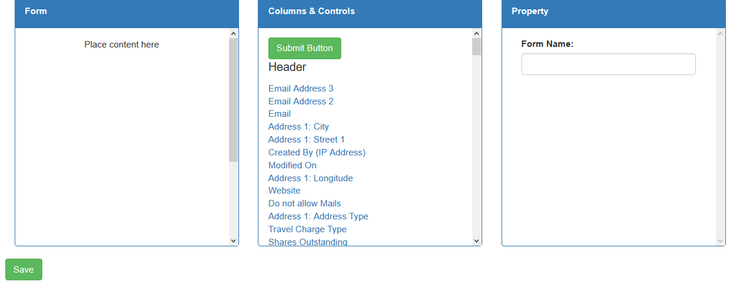
Form Design

Slide 6
Form URL Explanation
URL form in English
URL form in Vietnamese
Form
URL form in blue theme

Slide 7
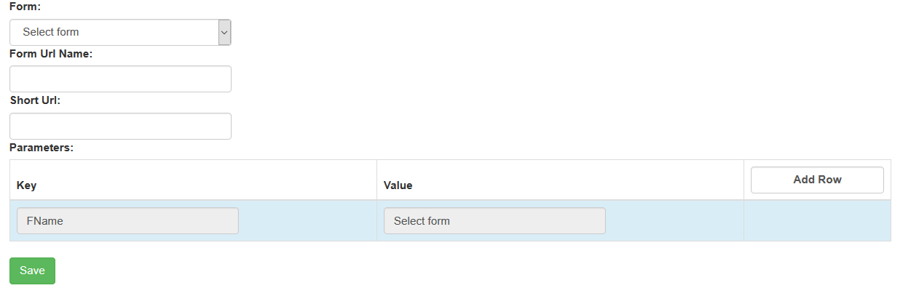
Form URL

Slide 8

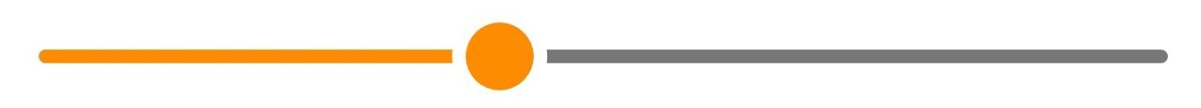
Extensibility
Add new control easily.
ControlTemplate.cshtml
Wrap HTML code inside <control></control> tag
Implement 3 functions for control: onLoad, getValue, setValue.
Declare context menu for form design.
Declare validation (if any).

Slide 9
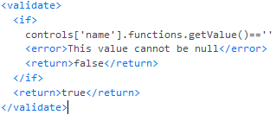
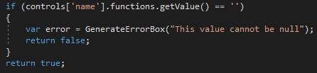
Extensibility
Drag and drop validation (50%).
https://vimeo.com/65583694 (00:20-00:30)

Slide 10
Extensibility
Multi entities implement.

